Slide 1
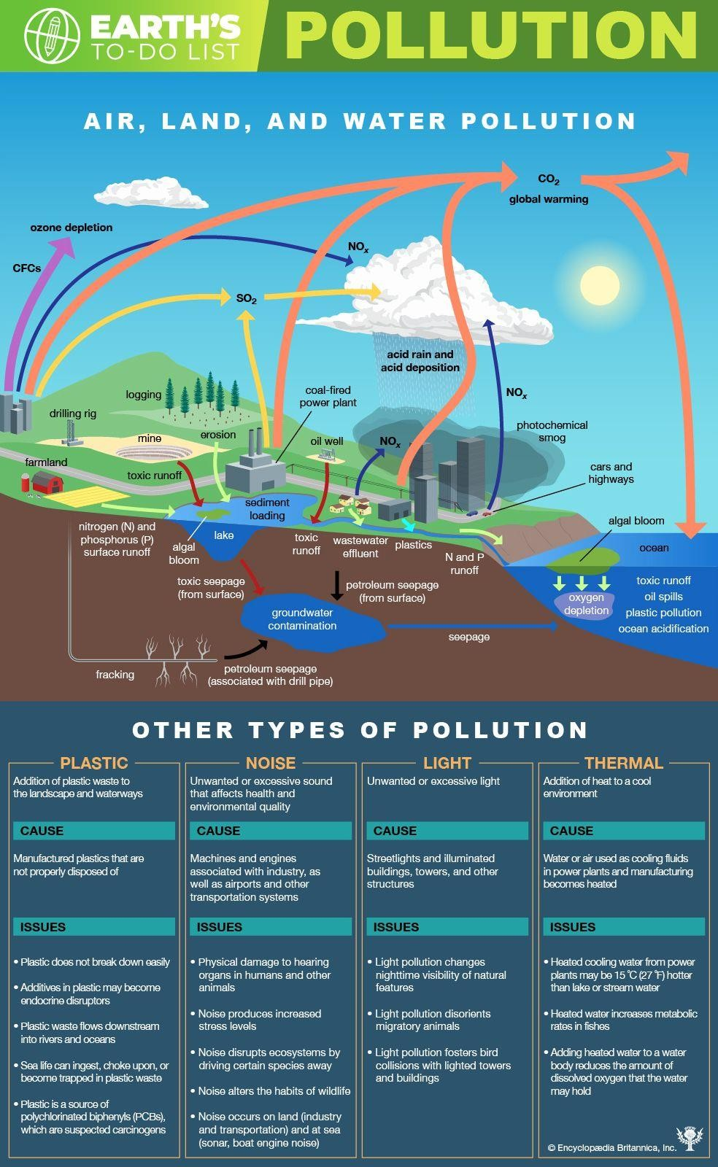
UNIT 3

Slide 2
POLLUTION-
Pollution, we probably hear of this term every other day at school, college and offices.
We also come across the term in newspapers, online journals, and media in general.
Pollution is the process of making land, water, air or other parts of the environment dirty and not safe or suitable to use.

Slide 3
POLLUTION-
This can be done through the introduction of a contaminant into a natural environment, but the contaminant doesn't need to be tangible. Things as simple as light, sound and temperature can be considered pollutants when introduced artificially into an environment.
With modernization and development in our lives, pollution of earth’s waterways, land and atmosphere has reached its peak, became threat to human illness and created one of the most serious environmental challenges facing the planet.

Slide 4
Pollution, also called environmental pollution is- the addition of any substance (solid, liquid, or gas) or any form of energy (such as heat, sound, or radioactivity) to the environment at a rate faster than it can be dispersed, diluted, decomposed, recycled, or stored in some harmless form.
The major kinds of pollution, usually classified by environment, are air pollution, water pollution, and land pollution. Modern society is also concerned about specific types of pollutants, such as noise pollution, light pollution and plastic pollution. Pollution of all kinds can have negative effects on the environment and wildlife and often impacts human health and well-being.

Slide 5
A pollutant is a substance that is present in concentrations that may harm organisms (humans, plants and animals) or exceed an environmental quality standard. The term is frequently used synonymously with contaminant.

Slide 6
History of Pollution-
Although environmental pollution can be caused by natural events such as forest fires and active volcanoes, the use of the word pollution generally implies that the contaminants have an anthropogenic source—that is, a source created by human activities.
Pollution has accompanied humankind ever since groups of people first congregated and remained for a long time in any one place. Indeed, ancient human settlements are frequently recognized by their wastes—shell mounds and rubble heaps, for instance.
Pollution was not a serious problem as long as there was enough space available for each individual or group. However, with the establishment of permanent settlements by people, urbanization and the rapid spread of industrialization, pollution became a problem, and it has remained one ever since.

Slide 7
History of Pollution-
.
By the middle of the 20th century, an awareness of the need to protect air, water, and land environments from pollution had developed among the general public.
In particular, the publication in 1962 of Rachel Carson’s book Silent Spring focused attention on environmental damage caused by improper use of pesticides such as DDT and other persistent chemicals that accumulate in the food chain and disrupt the natural balance of ecosystems on a wide scale.
In response, major pieces of environmental legislation, such as the Clean Air Act (1970) and the Clean Water Act (1972), were passed in many countries to control and mitigate environmental pollution.

Slide 8
Giving voice to the growing conviction of most of the scientific community about the reality of anthropogenic global warming, the Intergovernmental Panel on Climate Change (IPCC) was formed in 1988 by the World Meteorological Organization (WMO) and the United Nations Environment Program (UNEP) to help address greenhouse gas emissions.
An IPCC special report produced in 2018 noted that human beings and human activities have been responsible for a worldwide average temperature increase between 0.8 and 1.2°C (1.4 and 2.2°F) since preindustrial times, and most of the warming over the second half of the 20th century could be attributed to human activities, particularly the burning of fossil fuels.

Slide 9
Types/Forms of Pollution
Pollution occurs in different forms. Every form of pollution has two sources of occurrence; the point and the non-point sources. The point sources are easy to identify, monitor and control, whereas the non-point sources are hard to control.
On the basis of Environmental Components- Primitive classification
Water Pollution
Air Pollution
Soil/Land
.

Slide 10
On the basis of Pollutants- carrying a long list-
Chemical Pollution
Oil Pollution
Detergent Pollution
Soap Pollution
Radioactive Pollution
Noise Pollution Heat/Thermal
Light Pollution
.

Slide 11
WATER POLLUTION
Water Pollution is the contamination of water bodies (e.g. lakes, rivers, oceans, aquifers and groundwater).
Water pollution occurs when pollutants are directly or indirectly discharged into water bodies without adequate treatment to remove harmful compounds.
Water pollution affects plants and organisms living in these bodies of water. In almost all cases the effect is damaging not only to individual species and populations, but also to the natural biological communities.
Contaminants- Contaminants may include organic and inorganic substances.

Slide 12
Organic water pollutants include:
Detergents
Disinfection by-products found in
chemically disinfected drinking water, such
as chloroform
Food processing waste, which can include
oxygen-demanding substances, fats and
grease
Insecticides and herbicides, a huge range
of organohalides and other chemical
compounds
Petroleum hydrocarbons, including fuels
(gasoline, diesel fuel, jet fuels, and fuel oil)
and lubricants (motor oil), and fuel
combustion byproducts, from storm water
runoff
Various chemical compounds found in
personal hygiene and cosmetic products
Drug pollution involving pharmaceutical
drugs and their metabolites

Slide 13
Inorganic water pollutants include:
Acidity caused by industrial discharges
(as sulfur dioxide from power plants)
Ammonia from food processing waste
Chemical waste as industrial by-
products
Fertilizers containing nutrients—
nitrates and phosphates—which are
found in storm water runoff from
agriculture, as well as commercial and
residential use
Heavy metals from motor vehicles (via
urban storm water runoff) and acid mine
drainage
Silt (sediment) in runoff from
construction sites, logging, slash and
burn practices or land clearing sites.

Slide 14
There are two major sources when seen from the origin of the contamination. One is the ‘point’
source pollution, which means that the source of the pollution originates from a specific place. The
other is ‘nonpoint’ source pollution as contamination from diffuse options. Most causes of water
pollution originate from human activities and their waste products. The sources of water pollution
are numerous, but some of the major pollutants in today’s modern scenario are as follows:
Industrial Waste- Many regular industrial activities release enormous amounts of toxic chemicals
such as lead and mercury. They spread to other living species when humans use this Contaminated
product for regular purposes. It also affects the biodiversity of the water body.

Slide 15
Sewage and Waste- Tonnes of sewage waste is dumped into water bodies. This not only causes pollution, but also releases dangerous disease-causing pathogens.
Mining- Mining is key to the major lake and river pollution. This process brings out harmful
chemicals that are buried deep under the earth’s surface. When this comes in contact with water, the
effects are dangerous to any living creature.
Marine Dumping- The garbage generated every day is dumped into the seas and oceans going as
far as to give rise to garbage islands. An easy step of throwing waste products only in the bin can
reduce more than half of the water pollution levels.
Agricultural Activities- The use of chemical fertilizers, pesticides, and other runoffs during
irrigation flows into the water bodies. These chemicals cause pollution to water bodies in a short
span of time.
Radioactive Wastes- After usage of radioactive materials for nuclear wagons or as an energy
source, they are mostly dumped into water bodies or in glaciers that will immediately mix with
water when the temperature rises.
Urbanization and Population Growth- Cities are unable to meet the water demand of their growing population. Overuse causes contamination and loss of water.

Slide 16
.
Effects of Water Pollution
The effect of water pollution depends upon the
type of pollutants and their concentration. Also,
the location of water bodies is an important factor
to determine the levels of pollution.
Water bodies in the vicinity of urban areas are extremely polluted. This affects potable water supply in these areas.
EUTROPHICATION- Water pollution drastically affects aquatic life. It affects their metabolism, and behavior, and causes illness and eventual death.
BIOMAGNIFICATION- Dioxin is a chemical that causes a lot of problems from reproduction to uncontrolled cell growth or cancer. This chemical is bioaccumulated in fish, chicken and meat. Chemicals such as this travel up the food chain before entering the human body. Case Study- Minamata disease, first discovered in the city of Minamata, Japan in 1956, is an example of neurological disease caused by severe mercury poisoning.

Slide 17
.
Effects of Water Pollution
The effect of water pollution can have a huge impact on the food chain. It disrupts the food chain. Cadmium and lead are some toxic substances, these pollutants upon entering the food chain through animals (fish when consumed by animals, humans) can continue to disrupt at higher levels.
Humans are affected by pollution and can contract diseases such as hepatitis through faecal matter in water sources. Poor drinking water treatment and unfit water can always cause an outbreak of infectious diseases such as cholera, etc.
The ecosystem can be critically affected, modified and destructured because of water pollution.

Slide 18
Control of Pollution
Domestic sewage- Domestic sewage is typically 99.9 percent water with 0.1 percent pollutants. Well-designed and operated systems (i.e. secondary treatment or better) can remove 90 percent or more of these pollutants. Following methodology is being used to reduce discharges of untreated sewage, including:
utilizing a green infrastructure approach to improve storm water management capacity throughout the system, and reduce the hydraulic overloading of the treatment plant
repair and replacement of leaking and
increasing overall hydraulic capacity of the
sewage collection system (often a very
expensive option).

Slide 19
Industrial waste water- Industries that generate waste water with high concentrations of conventional pollutants (e.g. oil and grease), toxic pollutants (e.g. heavy metals, volatile organic compounds) or other non-conventional pollutants such as ammonia, need specialized treatment systems.
Agricultural waste water- Non point source controls. To minimize pesticide impacts, farmers may use Integrated Pest Management (IPM) techniques (which can include biological pest control) to maintain control over pests, reduce reliance on chemical pesticides, and protect water quality.

Slide 20
Urban runoff- Effective control of urban runoff involves reducing the velocity and flow of storm water, as well as reducing pollutant discharges. Local governments use a variety of storm water management techniques to reduce the effects of urban runoff. Pollution prevention practices include low-impact development techniques, installation of green roofs and improved chemical handling (e.g. management of motor fuels & oil, fertilizers and pesticides).
.

Slide 21
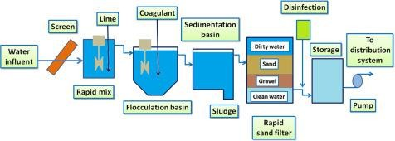
Water Treatment– Preliminary (Manual and Simple)- Elimination of debris and coarse wastes, Primary (Chemical and Mechanical)- Elimination of inorganic and suspended organic wastes, and Secondary (Biological) - Elimination of dissolved organic wastes.
Chemical Treatment

Slide 22
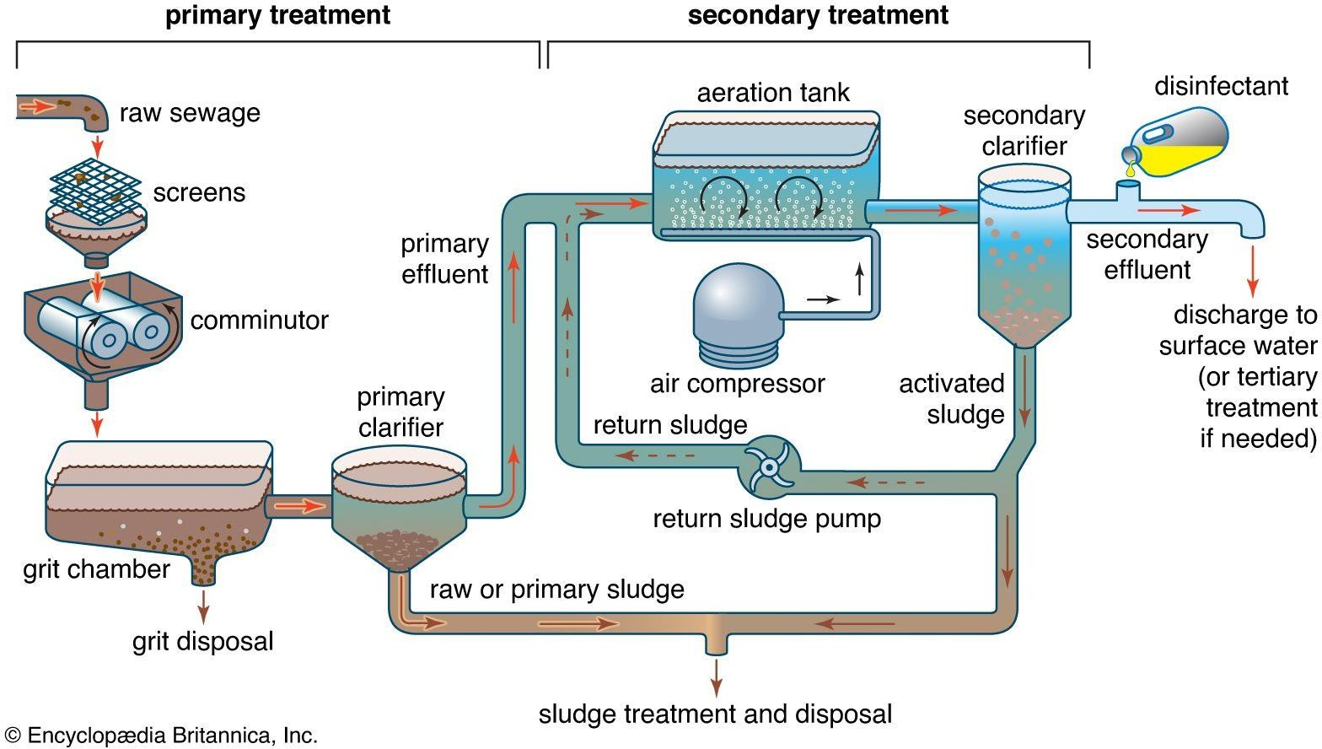

Slide 23
Primary Treatment
Primary treatment removes material that will either float or readily settle out by gravity. It includes the physical processes of screening, comminution, grit removal and sedimentation. Screens are made of long, closely spaced, narrow metal bars. They block floating debris such as wood, rags and other bulky objects that could clog pipes or pumps. In modern plants the screens are cleaned mechanically and the material is promptly disposed of by burial on the plant grounds. A comminutor may be used to grind and shred debris that passes through the screens. The shredded material is removed later by sedimentation or flotation processes.
Grit chambers are long narrow tanks that are designed to slow down the flow so that solids such as sand, coffee grounds and eggshells will settle out of the water. Grit causes excessive wear and tear on pumps and other plant equipment.

Slide 24
Suspended solids that pass-through screens and grit chambers are removed from the sewage in sedimentation tanks. These tanks also called primary clarifiers, provide about two hours of detention time for gravity settling to take place. As the sewage flows through them slowly, the solids gradually sink to the bottom. The settled solids—known as raw or primary sludge—are moved along the tank bottom by mechanical scrapers. Sludge is collected in a hopper, where it is pumped out for removal. Mechanical surface-skimming devices remove grease and other floating materials.
Chemical Treatment Methods
Some of the commonly used chemical
methods in wastewater treatment are-
1. Coagulation/flocculation,
2. Sedimentation,
3. Disinfection

Slide 25
Secondary Treatment
Secondary treatment removes the soluble organic
matter that escapes primary treatment. It also
removes more of the suspended solids. Removal is
usually accomplished by biological processes in
which microbes consume the organic impurities as
food, converting them into carbon dioxide,
water, and energy for their own growth and
reproduction. The sewage treatment plant provides
a suitable environment, albeit of steel and
concrete, for this natural biological process.
Removal of soluble organic matter at the
treatment plant helps to protect the dissolved
oxygen balance of a receiving stream, river, or
lake.

Slide 26
There are three basic biological treatment methods:
the trickling filter, the activated sludge process,
and the oxidation pond. A fourth, less common
method is the rotating biological contacter.
-Trickling filter
A trickling filter is simply a tank filled with a deep bed of stones. Settled sewage is sprayed continuously over the top of the stones and trickles to the bottom, where it is collected for further treatment.
As the wastewater trickles down, bacteria gather and multiply on the stones.
The steady flow of sewage over these growths allows the microbes to absorb the dissolved organics, thus lowering the biochemical oxygen demand (BOD) of the sewage.
Air circulating upward through the spaces among the stones provides sufficient oxygen for the metabolic processes.

Slide 27
Settling tanks, called secondary clarifiers, follow the trickling filters.
These clarifiers remove microbes that are washed off the rocks by the flow of wastewater. Two or more trickling filters may be connected in series, and sewage can be recirculated in order to increase treatment efficiencies.

Slide 28
-Activated sludge
The activated sludge treatment system consists of an aeration tank followed by a secondary clarifier.
Settled sewage, mixed with fresh sludge that is recirculated from the secondary clarifier, is introduced into the aeration tank. Compressed air is then injected into the mixture through porous diffusers located at the bottom of the tank.
As it bubbles to the surface, the diffused air provides oxygen and a rapid mixing action. Air can also be added by the churning action of mechanical propeller-like mixers located at the tank surface.
Under such oxygenated conditions, microorganisms thrive, forming an active, healthy suspension of biological solids—mostly bacteria—called activated sludge. About six hours of detention is provided in the aeration tank. This gives the microbes enough time to absorb dissolved organics from the sewage, reducing the BOD.

Slide 29
The mixture then flows from the aeration tank into the secondary clarifier, where activated sludge settles out by gravity.
Clear water is skimmed from the surface of the clarifier, disinfected, and discharged as secondary effluent.
The sludge is pumped out from a hopper at the bottom of the tank.

Slide 30
-Oxidation pond
Oxidation ponds, also called lagoons or stabilization ponds, are large, shallow ponds designed to treat wastewater through the interaction of sunlight, bacteria, and algae.
Algae grow using energy from the sun and carbon dioxide and inorganic compounds released by bacteria in water.
During the process of photosynthesis, the algae release oxygen needed by aerobic bacteria.
Mechanical aerators are sometimes installed to supply yet more oxygen, thereby reducing the required size of the pond.
Sludge deposits in the pond must eventually be removed by dredging.
Algae remaining in the pond effluent can be removed by filtration or by a combination of chemical treatment and settling.

Slide 31
Tertiary Treatment
When the intended receiving water is very
vulnerable to the effects of pollution,
secondary effluent may be treated further
by several tertiary processes.
Biochemical oxygen demand (BOD) and Chemical oxygen demand (COD)
Biochemical oxygen demand (BOD) is the amount of oxygen microorganisms require to break down organic materials.
In contrast, chemical oxygen demand (COD) is the amount of oxygen required to break down the organic material via oxidation. Hence, the value of COD is greater than BOD.

Slide 32
BOD | COD
BOD is a biological oxidation process | COD is a chemical oxidation process
BOD is performed by aerobic organisms | COD is performed by chemical reagents - potassium dichromate (K2Cr2O7) in combination with boiling sulfuric acid (H2SO4)

Slide 33
BOD | COD
BOD is measured by keeping a sealed water sample for incubation for a period of 5 days at 20 degree Celsius. The reduction in dissolved oxygen gives the amount of oxygen consumed by the aerobic organisms. | In COD test, the water sample is incubated with a strong oxidant in combination with boiling sulphuric acid for a specific period of time and temperature.
BOD value is determined by 5 days. | COD can measured within few days.
BOD value is lower than COD | COD value is always greater than BOD

Slide 34
BOD | COD
BOD is used to oxidize the natural organic matter and organic waste in the water | COD is capable of degrading the industrial sewage. COD does not measure the amount of oxygen consumed by acetates present in the water sample

Slide 35
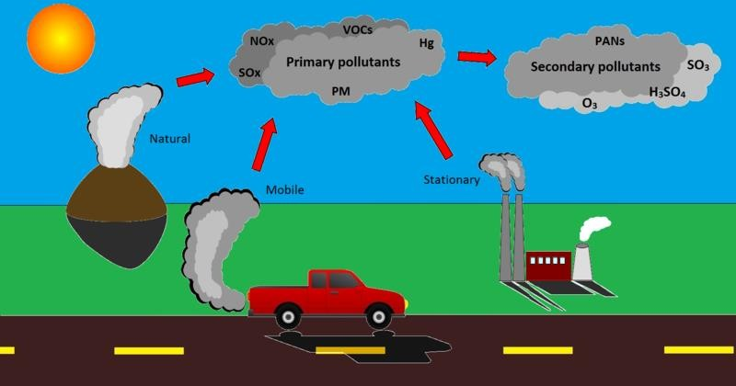
AIR POLLUTION
Definition- Air pollution is the introduction of particulates, biological molecules, or other harmful materials into the Earth's atmosphere, possibly causing disease, death to humans, damage to other living organisms such as food crops or the natural or built environment.
Pollutants are the elements, molecules and particles involved in pollution - life can be harmed when exposed to these materials, and the effects of them on humans and plants are well known. Pollutants can be introduced into the environment in many ways, both naturally and by humans. Air borne emissions emitted from various industries are a cause of major concern. These emissions are of two forms, viz. solid particles (SPM) and gaseous emissions (aerosols). Thus, Air Pollutants can be solid particles, liquid droplets, or gases. They can be natural or manmade. The pollutants have been classified into primary and secondary categories.
The primary pollutants are “directly” emitted from the processes such as fossil fuel consumption, Volcanic eruption and factories. The major primary pollutants are Oxides of Sulphur, Oxides of Nitrogen, Oxides of Carbon, Particulate Matter, Methane, Ammonia, Chlorofluorocarbons, Toxic metals etc.
The secondary pollutants are not emitted directly. The secondary pollutants form when the primary pollutants react with themselves or other components of the atmosphere. Most important secondary level Air Pollutants are Ground Level Ozone, Smog and POPs (Persistent Organic Pollutants).
Ground Level Ozone
The most important secondary pollutant is the Ground Level Ozone or Tropospheric Ozone. Emissions from industrial facilities and electric utilities, motor vehicle exhaust, gasoline vapours, and chemical solvents are some of the major sources of Nox and VOC. Ground Level Ozone forms due to reactions of the NOx, Carbon Monoxide and VOCs in presence of sunlight.
Smog

Slide 36
Another most important secondary pollutant is the Smog, which has made up of Smoke and Fog. Traditionally, the smog has resulted from large amounts of coal burning in an area caused by a mixture of smoke and sulphur dioxide. Now-a-days, the Vehicle emissions and Industrial emissions that are acted on in the atmosphere by ultraviolet light from the sun to form secondary pollutants that also combine with the primary emissions to form photochemical smog.
Sources of Air Pollution
Anthropogenic (man-made) sources: These are mostly related to the burning of multiple types of fuel.
Stationary sources include smoke stacks of power plants, manufacturing facilities (factories) and waste incinerators, as well as furnaces and other types of fuel-burning heating devices.
Mobile sources include motor vehicles, marine vessels, and aircraft.
Fumes from paint, hair spray, varnish, aerosol sprays and other solvents
Waste deposition in landfills, which generate methane. Methane is highly flammable and
may form explosive mixtures with air. Methane is also an asphyxiant and may displace oxygen in an enclosed space. Asphyxia or suffocation may result if the oxygen concentration is reduced to below 19.5% by displacement.
Military resources, such as nuclear weapons, toxic gases, germ warfare and rocketry
Natural sources:
Dust from natural sources, usually large areas of land with few or no vegetation
Methane, emitted by the digestion of food by animals, for example cattle
Radon gas from radioactive decay within the Earth's crust..
Smoke and carbon monoxide from forestfires
Volcanic activity, which produces sulfur, chlorine, and ash particulates
Effects of Air Pollution
Respiratory and heart problems: The effects of Air pollution are alarming. They are known to create several respiratory and heart conditions along with Cancer, among other threats to the body.
Global warming: With increased temperatures world wide, increase in sea levels and melting of ice from colder regions and icebergs, displacement and loss of habitat are also due to rise in the air pollution levels.
Acid Rain: Harmful gases like nitrogen oxides and sulfur oxides are released into the atmosphere during the burning of fossil fuels. When it rains, the water droplets combines with these air pollutants, becomes acidic and then falls on the ground in the form of acid rain. Acid rain can cause great damage to human, animals and crops.
Eutrophication: It is a condition where high amount of nitrogen present in some pollutants gets developed on sea’s surface and turns itself into algae and adversely affect fish, plants and animal species.

Slide 37
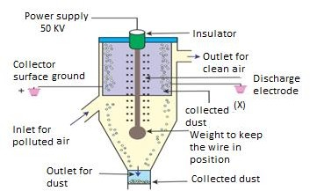
Effect on Wildlife: Toxic chemicals present in the air can force wildlife species to move to new place and change their habitat. The toxic pollutants deposit over the surface of the water and can also affect sea animals.
Depletion of Ozone layer: Earth’s ozone layer is depleting due to the presence of chlorofluorocarbons, hydro chlorofluorocarbons in the atmosphere. As ozone layer will go thin, it will emit harmful rays back on earth and can cause skin and eye related problems. UV rays also have the capability to affect crops.
Solutions for Air Pollution
Use public mode of transportation: Encourage people to use more and more public modes of transportation to reduce pollution. Also, try to make use of car pooling.
Conserve energy: Switch off fans and lights when you are going out. Large amount of fossil fuels is burnt to produce electricity.
The concept of Refuse, Reduce, Reuse and Recycle: Follow the 4-R Principal.
Emphasis on clean energy resources: Clean energy technologies like solar, wind and geothermal should be used.
Use energy efficient devices: CFL lights consume less electricity as against their counterparts. They live longer, consume less electricity, lower electricity bills and also help you to reduce pollution by consuming less energy.
Control through Devices
The following items are used as pollution control devices to destroy contaminants or remove them from an exhaust stream before it is emitted into the atmosphere-
Electrostatic Precipitators:
between the plates should be low enough to permit the dirt to fall.
Electrostatic precipitators are very economical devices that take away about ninety nine percent of particulate present within the industrial and thermal power exhausts. They include charged plates are square measure connected to the bottom. The electrode wires are supplied with high voltage current that turn out a corona that releases electrons. These electrons attach to the dirt particles giving them a negative charge. The aggregation particles are grounded and attract the charged dirt particles. The speed of air

Slide 38
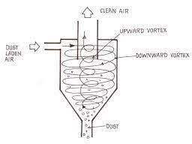
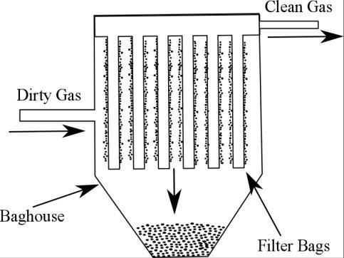
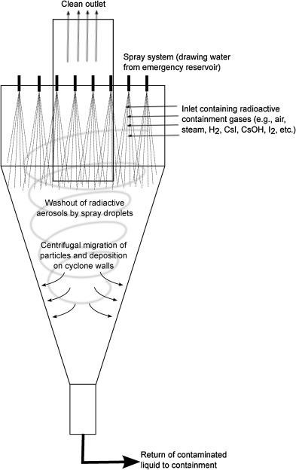
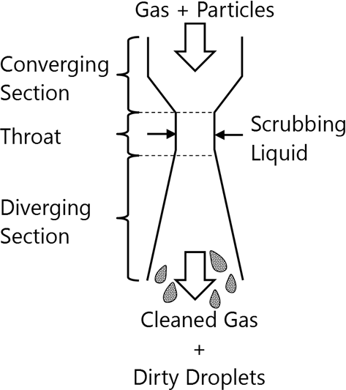
Cyclone Separators:
Cyclonic separation is a method of removing particulates from an air, gas or liquid stream, without the use of filters, through vortex separation. When removing particulate matter from liquid, a hydrocyclone is used; while from gas, a gas cyclone is used. Rotational effects
and gravity are used to separate mixtures of solids and fluids.
Baghouses:
Designed to handle heavy dust loads, a dust collector consists of a blower, dust filter, a filter-cleaning system, and a dust receptacle or dust removal system (distinguished from air cleaners which utilize disposable filters to remove the dust).
Particulate Scrubbers:
A wet scrubber is a form of pollution control technology. The term describes a variety of devices that use pollutants from a furnace flue gas or from other gas streams. In a wet scrubber, the polluted gas stream is brought into contact with the scrubbing liquid, by spraying it with the liquid, by forcing it through a pool of liquid, or by some other contact method, so as to remove the pollutants. Ex- Spray Tower or Wet Scrubber, Ejector venturi scrubber

Slide 39
Airborne infection
Definition. An airborne disease is any disease that is caused by pathogens and transmitted through the air. The pathogens may be viruses, bacteria, or fungi, and they may be spread through coughing, sneezing, raising of dust, spraying of liquids, or similar activities. Airborne pathogens or allergens often cause inflammation in the nose, throat, sinuses and the lungs. This is caused by the inhalation of these pathogens that affect a person's respiratory system or even the rest of the body. Sinus congestion, coughing and sore throats are examples of inflammation of the upper respiratory air way due to these airborne agents. Many common infections can spread by airborne transmission such as Anthrax (inhalational), Chickenpox, Influenza, Measles, Smallpox, Cryptococcosis, and Tuberculosis.
Sinus congestion, coughing and sore throats are examples of inflammation of the upper respiratory air way due to these airborne agents.
Causes
An airborne disease can be caused by exposure to a source: an infected patient or animal, by being transferred from the infected person or animal’s mouth, nose, cut, or needle puncture. People receive the disease through a portal of entry: mouth, nose, cut, or needle puncture.
Prevention
Some ways to prevent airborne diseases include washing hands, using appropriate hand disinfection, getting regular immunizations against diseases believed to be locally present, wearing a respirator and limiting time spent in the presence of any patient likely to be a source of infection.

Slide 40
SOIL POLLUTION
Definition. Soil pollution is defined as the build-up in soils of persistent toxic compounds, chemicals, salts, radioactive materials, or disease-causing agents, which have adverse effects on plant growth and animal health. There are many different ways that soil can become polluted, as:
Seepage from a landfill.
Discharge of industrial waste into the soil
Percolation of contaminated water into the soil
Rupture of underground storage tanks
Excess application of pesticides, herbicides or fertilizer
Solid waste seepage
Types of Soil Pollution
Agricultural Soil Pollution.
Soil pollution by industrial effluents and solid wastes
Pollution due to urban activities
Causes of Soil Pollution
Indiscriminate use of fertilizers. The over use of NPK fertilizers reduce quantity of vegetables and crops grown on soil over years. It also reduces the protein content and the carbohydrate quality of the crops.
Indiscriminate use of pesticides, insecticides and herbicides. The remnants of such
pesticides used on pests may get adsorbed by the soil particles, which then contaminate root crops grown in that soil.
Dumping of solid wastes. Solid waste includes garbage, domestic refuse and discarded solid materials such as from commercial, industrial and agricultural operations.
Chemicals released by industrial wastes. They are also toxic in nature.
Effects of Soil Pollution
Agriculture. Reduces soil fertility, nitrogen fixation, loss of soil and nutrients, crop yield, imbalance in soil fauna and flora, etc. are the common losses of soil pollution.
Clogging of drains
Public health problems
Pollution of drinking water sources
Foul smell and release of gases
Control of Soil Pollution
The following steps have been suggested to control soil pollution. To help prevent soil erosion,
1. Limit construction in sensitive area.

Slide 41
We can adopt the four R's: Refuse, Reduce, Reuse, and Recycle. This would give us less solid waste
Reducing chemical fertilizer and pesticide use Applying bio-fertilizers and manures can reduce chemical fertilizer and pesticide use.
Biological methods of pest control can also reduce the use of pesticides and thereby minimize soil pollution.
Recycling and recovery of materials: Materials such as paper, some kinds of plastics and glass can and are being recycled.
Reforesting Control of land loss and soil erosion can be attempted through restoring forest and grass cover to check wastelands, soil erosion and floods. Crop rotation or mixed cropping can improve the fertility of the soil.
Solid waste treatment Proper methods should be adopted for management of solid waste disposal. Industrial wastes can be treated physically, chemically and biologically until they are less hazardous.

Slide 42
NOISE POLLUTION
Definition- Noise pollution takes place when there is either excessive amount of noise or an unpleasant sound that causes temporary disruption in the natural balance. This definition is usually applicable to sounds or noises that are unnatural in either their volume or their production. Even electrical appliances at home are also a constant source of noise pollution.

Slide 43
Causes of Noise Pollution
Industrialization: Most of the industries use big machines which are capable of producing large amount of noise. Apart from that, various equipments like compressors, generators, exhaust fans, grinding mills also participate in producing big noise.
Poor Urban Planning: In most of the developing countries, poor urban planning also plays a vital role. Congested houses, large families sharing small space, fight over parking, frequent fights over basic amenities lead to noise pollution which may disrupt the environment of society.
Social Events: Noise is at its peak in most of the social events, eg., a marriage, parties, pub, disc or place of worship

Slide 44
Transportation: Large number of
vehicles on roads, aeroplanes flying over
houses, underground trains produce
heavy noise and people get it difficult to
get accustomed to that.
Construction Activities: Under construction activities like mining, construction of bridges, dams, buildings, stations, roads, flyovers take place in almost every part of the world.
Household Chores: Gadgets like TV, mobile, mixer grinder, pressure cooker, vacuum cleaners, washing machine and dryer, cooler, air conditioners also contribute to noise pollution.
.

Slide 45
.Effects of Noise Pollution
Hearing Problems: Our ears can take
in a certain range of sounds without
getting damaged. Constant exposure to
loud levels of noise can easily result in
the damage of our ear drums and loss of
hearing.
Health Issues: Excessive noise
pollution in working areas such as offices,
construction sites, bars and even in our
homes can influence psychological
health.
Sleeping Disorders: Loud noise can
certainly hamper your sleeping pattern
and may lead to irritation and
uncomfortable situations.
Cardiovascular Issues: Blood pressure
levels, cardio-vascular disease and stress
related heart problems are on the rise.
High intensity noise causes high blood
pressure and increases heart beat rate as it
disrupts the normal blood flow.

Slide 46
Trouble Communicating: High decibel noise can put trouble and may not allow two people to communicate freely. Constant sharp noise can give you severe headache and disturb your emotional balance.
Effect on Wildlife: In nature, animals
may suffer from hearing loss, which makes
them easy prey and leads to dwindling
populations.

Slide 47
Control of Noise Pollution
On a personal level, everybody can
help reducing the noise in their homes by
lowering the volume of the radio, music
system and the television.
2. Removal of public loudspeakers is another way in which the pollution can be controlled.
3. Urban planning can be done in a
better way. ‘No-Noise’ zones, where
honking and industrial noise are not
tolerated.

Slide 48
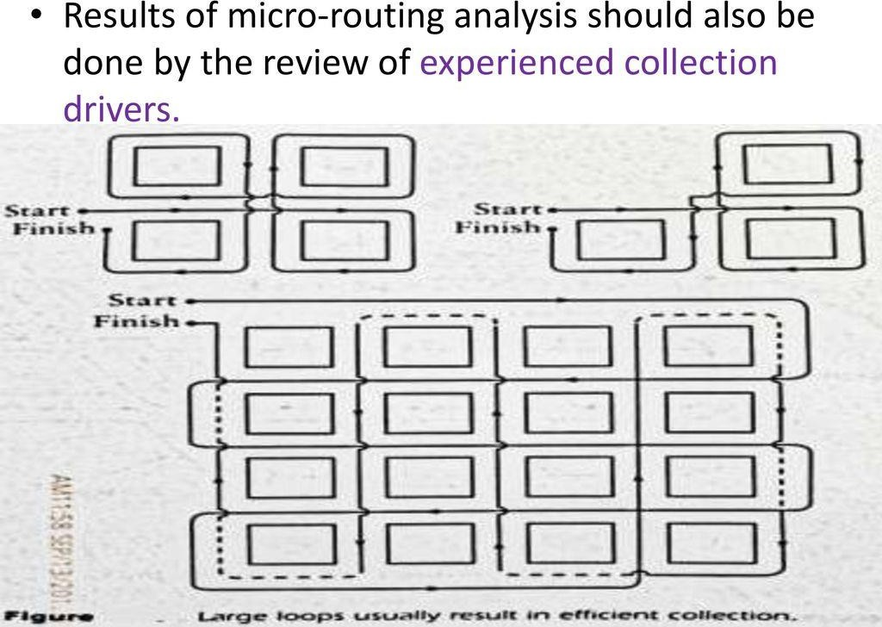
SOLID WASTE MANAGEMENT
Waste Management
Waste management is the “generation, prevention, characterization, monitoring, treatment, handling, reuse and residual disposition of solid wastes”. There are various types of solid waste including municipal (residential, institutional, commercial), agricultural, and special (health care, household hazardous wastes, sewage sludge).
Collection, Transport and Disposal of SW
Collection- According to mode of operation collection system classified into two categories:
Hauled Container system (HCS) Storage containers hauled to disposal site, emptied and return to original or some other locations.
Stationary Container System (SCS)Storage containers remain at the point of generation, except
moved to curb or other location to empty.
Transport
Types of Waste Disposal
There are eight major groups of waste management methods, each of them divided into numerous categories. Those groups include source reduction and reuse, animal feeding, recycling, composting, fermentation, landfills, incineration and land application.

Slide 49
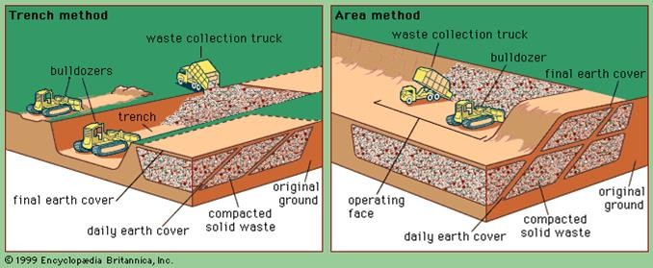
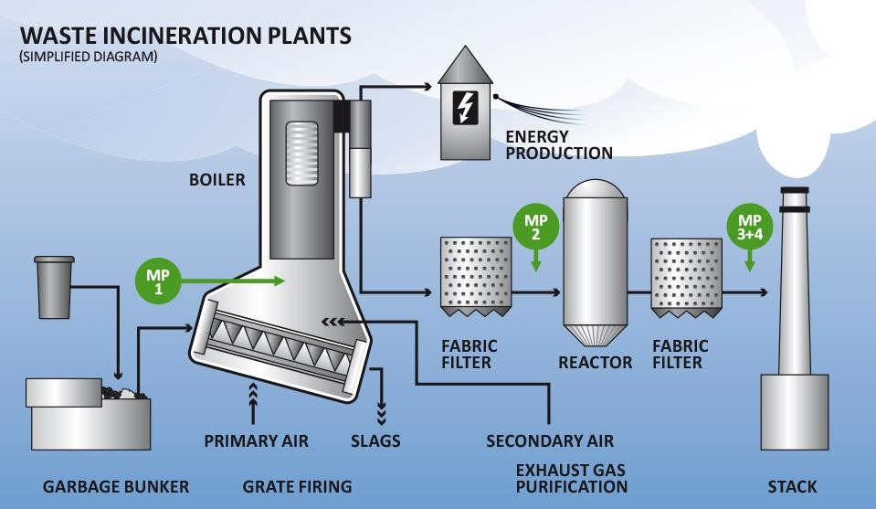
Methods of Waste Disposal
Solid Waste Open Dumping/Burning
Solid waste open dumping / burning is not the perfect method in the present scenario.
Landfills
The Landfill is the most popularly used method of waste disposal used today. This process of waste
disposal focuses attention on burying the waste in the land. Landfills are found in all areas. Solid wastes sanitary landfills process is simple, clean and effective. In this procedure, layers are compressed with some mechanical equipment and covered with earth, levelled, and compacted. A deep trench of 3 to 5 m is excavated and micro-organisms act on the organic matter and degrade them. In this procedure, refuse depth is generally limited to 2m. Facultative bacteria hydrolyze complex organic matter into simpler water-soluble organics.
Incineration/Combustion
Incineration or combustion is a type disposal method in which municipal solid wastes are burned at high temperatures so as as to convert them into residue and gaseous products. The biggest
advantage of this type of method is that it can reduce the volume of solid waste to 20 to 30 percent of the original volume, decreases the space they take up and reduce the stress on landfills. This process is also known as thermal treatment where solid waste materials are converted
by Incinerators into heat, gas, steam and ash.

Slide 50
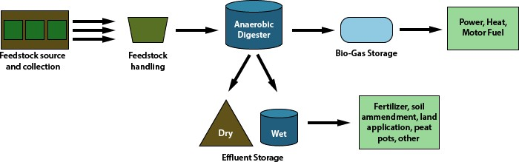
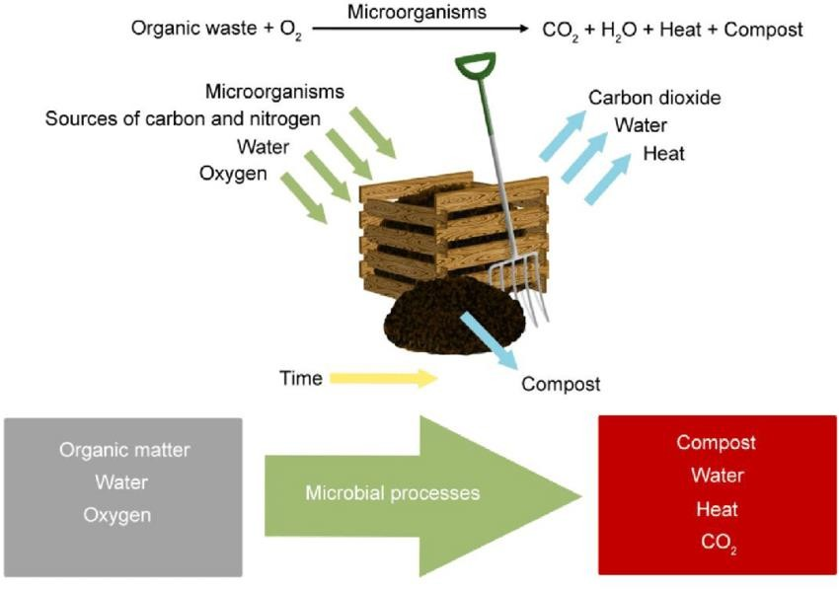
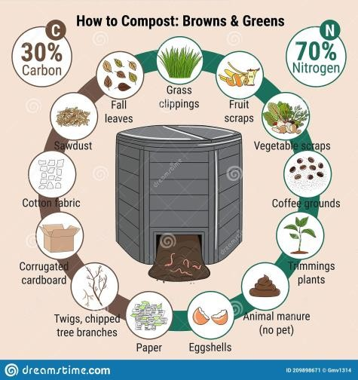
Composting
Composting is a easy and natural bio-degradation process that takes organic wastes i.e. remains of
plants and garden and kitchen waste and turns into nutrient rich food for your plants. Composting, normally used for organic farming, occurs by allowing organic materials to sit in one place for months until microbes decompose it. It is popular in developing countries. Composting is one of the best methods of waste disposal as it can turn unsafe organic products into safe compost, That can be used as a base for fertilizers. On the other side, it is slow process and takes lot of space.
Two methods have been used in this process:
Open Window Composting
Mechanical Composting
Salvaging (Recovery and Recycling)
Resource recovery is the process of taking useful discarded items for a specific next use. These discarded items are then processed to extract or recover materials and resources or convert them to
energy in the form of useable heat, electricity or fuel. Recycling is the process of converting waste products into new products to prevent energy usage and consumption of fresh raw materials. Materials such as metal, paper, glass, rags, certain types of plastic and so on can be salvaged,
recycled, and reused

Slide 51
Plasma Gasification
During the treatment solid waste by plasma gasification, the waste’s molecular bonds are broken
down as result of the intense heat in the vessels and the elemental components. This form of waste disposal provides renewable energy and an assortment of other fantastic benefits.
Avoidance/Waste Minimization
The easier method of waste management is to reduce creation of waste materials thereby reducing the amount of waste going to landfills. Waste reduction can be done through recycling old materials
like jar, bags, repairing broken items instead of buying new one, avoiding use of disposable products like plastic bags, reusing second hand items, and buying items that uses less designing.
Waste Disposal in Deep Sea
Not advisable, until alternative methods are possible, as sea itself is a natural resource.

Slide 52
Extra Topic
e-WASTE MANAGEMENT
Why e-Waste is a problem?
Electronic waste is discarded electronic or electrical equipment and devices. Used electronics that are intended for reuse, salvage, resale, disposal, or recycling are also referred to as e-waste. They are harmful to the environment because of the presence of harmful chemicals like brominated flame retardants and toxic heavy metals like mercury, cadmium, lead etc. Informal or unorganized processing of e-waste particularly in developing nations can affect human health adversely and also cause pollution of the environment. Also, the Environment, Forest and Climate Change Ministry has announced the E-Waste Management Rules 2016. These new rules replaced the earlier E-Waste (Management and Handling) Rules of 2011.
e-Waste in India
As India is the fifth largest E-waste producing country in the world, aspirants should know that E- waste is a term used for those electronic products which are near to the end of their useful life. Some examples of E-waste are: Computers, Televisions, VCRs, Stereos, Copiers, and Fax machines
Electronic scrap materials like CPUs consist of possibly harmful substances like lead, beryllium, cadmium, or brominated flame retardants. The recycling and disposal of such electronic waste involve great risk to the workers and communities in developing nations. A lot of care must be taken to prevent hazardous exposure in recycling operations. Care must also be taken to prevent the leaking of harmful materials such as heavy metals from incinerator ashes and landfills.
Environmental Impacts of e-Waste
The toxic chemicals present in the e-waste releases into the atmosphere when it warms up. The lead, zinc, barium etc, found in electronic waste tend to harm human health. Also, when e-waste meets the landfills, the toxic chemicals seep into the soil and water, leading to groundwater pollution that further impacts sea health and human health.
Minimizing e-Waste is Important
Re-evaluate. Do we really need extra gadget? Find one device with multiple functions.
Extend the life of your electronics. Buy a case, keep your device clean, and avoid overcharging the battery.
Buy environmentally friendly electronics. Look for products labeled Energy Star or certified by the Electronic Product Environmental Assessment Tool (EPEAT).
Donate used electronics to social programs—and help victims of domestic violence,
children safety initiatives, environmental causes, and more.
Reuse large electronics
Recycle electronics and batteries in e-waste recycling bins located around campus.
Large electronics can go in the larger bins found in your building.

